Slide 1
^{Chapter 2} Abstract Data Types
ZAMAN UNIVERSITY
Data Structures and Algorithms

Slide 2
Outline
Stacks
Queues and Priority Queues
Linked Lists
Abstract Data Types
Specialized Lists

Slide 3
Outline
Stacks
Queues and Priority Queues
Linked Lists
Abstract Data Types
Specialized Lists

Slide 4
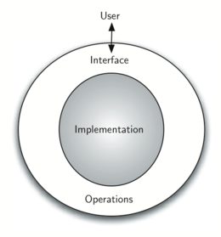
Abstract Data Types
What is Abstract Data Types? ADT, is a logical description of how we view the data and the operations, that are allowed without regard to how they will be implemented.
Actually, Stack & Queue were
implemented by using array in the
previous lectures. Now, we will show
how to implement Stack & Queue
by using Linked List.
Since, we will provide the same
operations/interface
to users.

Slide 5
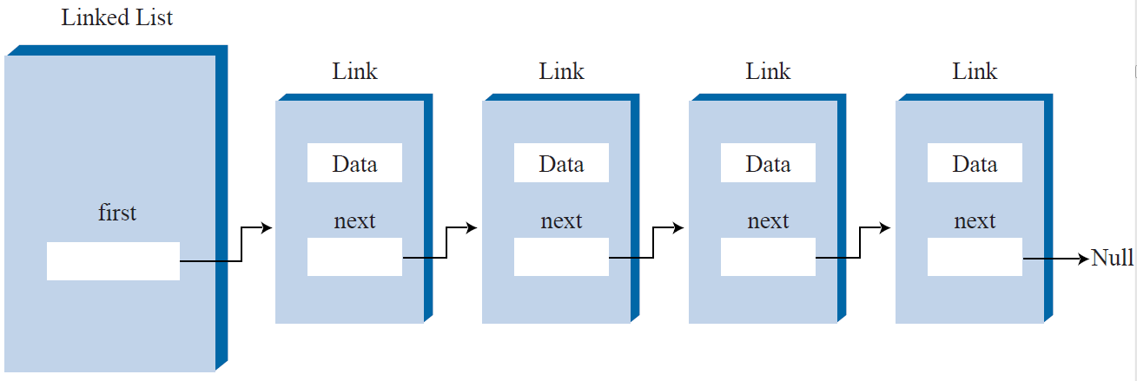
Implement a Stack using Linked List
Top

Slide 6
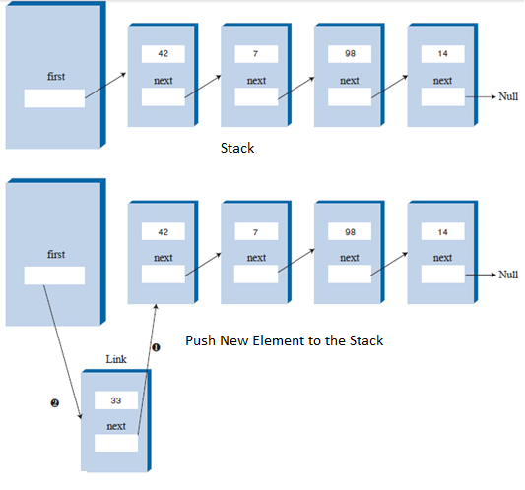
Stack Operation (with Linked List): Push
Operation Push
Actually, it is the
operation of insertion new link to the first
Top

Slide 7
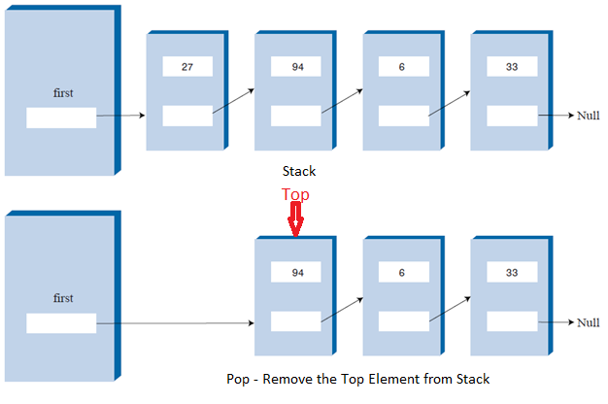
Stack Operation (with Linked List): Pop
Operation Pop
Remove the first Link from Linked List

Slide 8

Create Stack by Using Linked List with the following operations: Push, Pop, Peek, Size, isEmpty, isFull

Slide 9
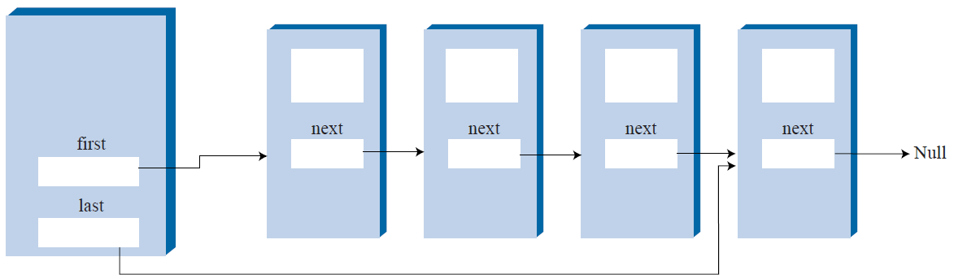
Double-Ended List
It will be faster to implement Queue with Double-Ended Lists, during insertion element to Queue.
Double-Ended Lists

Slide 10
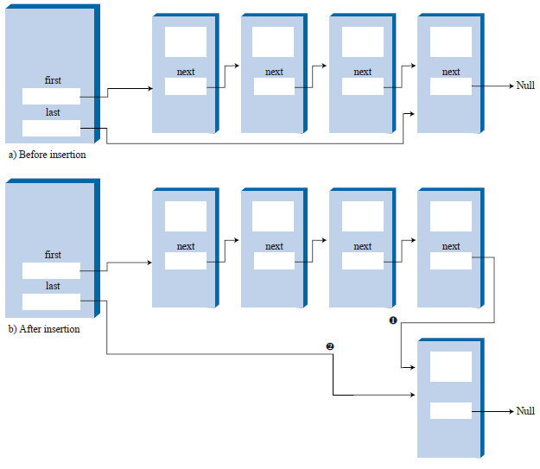
Implement Queue Using Double-Ended List
Operation Insertion

Slide 11
class DELinkList{
Link* pFirst; //ptr to first link on list
Link* pLast; //ptr to the last link on list
public:
void InitLinkList();
bool IsEmpty(); //Return true – empty, else return false
bool IsFull(); //Return true – full, else return false
void Remove ();//Remove the first link from list (in Q – Remove)
void Insert (); //Insert the new link to the tail of list (in Q – Insert)
Link *PeekFront(); //Return the first link on list
int Size(); //Return the number link in the lists
};
void DELinkList::InitLinkList(){
pFirst = NULL;
pLast = NULL; //(no links on list yet)
};

Slide 12
Create Queue by Using Double-Ended Linked List with the following operations: Insert, Remove, PeekFront, Size, isEmpty, isFull

Slide 13
Outline
Stacks
Queues and Priority Queues
Linked Lists
Abstract Data Types
Specialized Lists

Slide 14
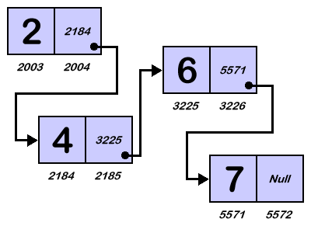
Sorted Linked List
In a sorted list, the items are arranged in sorted order by key value.
The advantages of
a sorted list over a sorted
array are speed of
insertion because
elements don’t need to be moved and the fact
that a list can expand to fill
available memory,
whereas an array is limited.

Slide 15
Implement the Sorted List
Data of link in the list will be sorted, when we arrange them during the operation insertion.
The insertion function is more complicated for sorted lists than for unsorted lists.
To insert an item into a sorted list, the algorithm must first search through the list until it finds the appropriate place to put the item.

Slide 16
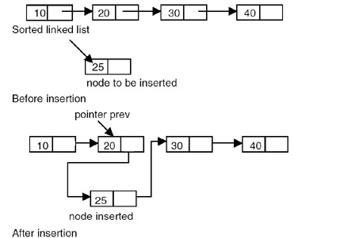
Insertion Link to the Sorted Linked List

Slide 17
Create Sorted Linked List with the following operations: InsertInOrder, RemoveFirst, Size, isEmpty, isFull

Slide 18
To be continued…

